Slide 1

LLMs: Introduction and Confronting Challenges
Bhavishya Pandit

Slide 2






Large Language Models: Making Waves in Artificial Intelligence
What is a Large Language Model?
A Large Language Model (LLM) is a powerful computer program trained on massive amounts of text data. This allows it to understand and generate human-like language at ease.
Benefits
Applications
Increased efficiency
Increased communication
Enhanced Creativity
Translation
Summarization
Intelligent Chatbots
It can automate tasks that involve understanding
and processing text
It improves communication between people who speak different languages.
LLMs can be used as creative tools to generate new ideas and content.
LLMs can translate languages more accurately and naturally.
LLMs can provide summaries of factual topics or large amounts of text.
LLMs can power chatbots that can have more engaging and informative conversations with users.

Slide 3


How reliable can LLMs be?
LLMs are good to use as they reduce manual effort and act as a catalyst when it comes to development of AI enabled products. But LLMs have their cons as well – especially in terms of reliability of response and security threat.
Reliability of response
Security threat
Hallucinations refer to instances where the model generates text that appears plausible but is factually incorrect or internally inconsistent with the real world.
Injections refer to instances where the model is fed with additional information acting upon which might be detrimental.
Hallucinations
Injections
Why does it happen?
Why does it happen?
It stems from limitations in how LLMs process information. They're trained on massive amounts of text data, which can contain inconsistencies or biases. The model can then pick up on these patterns and inadvertently replicate them, leading to outputs that seem real but aren't.
LLMs rely on user prompts to understand what's expected of them. Unfortunately, this can be exploited by attackers who craft deceptive prompts to get the LLM to do their bidding.

Slide 4
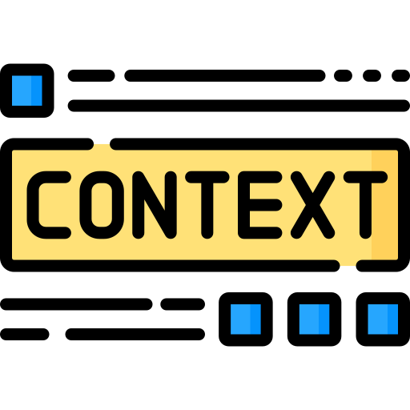

How to tackle the challenges?
Enough of talking about the challenges. Let’s understand how we can tackle them!
Hallucinations
Injections
Hallucinations happen because of inconsistencies in the data that the model has been trained on or it happens because of lack of context.
Injections happen when users write malicious prompts in a way that forces the LLM to act or share information in a certain way.
Solution
Solution
Provide relevant context/information to LLM that can help it understand what response is to be given and when thereby controlling LLM from hallucinating.
Build security layer(s) that identifies and prevents user’s prompts from injecting LLM into giving outputs that might cause some breaches.

